Slide 1
The Evidence Aspect in Cyber Law
Vishram V Kunte
16th Sept 2023

Slide 2
Panama Paper Leak
Mariam Nawaz Sharif purchase of high-end London property acquired through offshore companies in the British Virgin Islands.
Documents claiming that Mariam Nawaz Sharif was only a trustee of the companies that bought the London flats, are dated February 2006, and appear to be typed in Microsoft Calibri font
But the font was only made commercially available in 2007, leading to suspicions that the documents are forged.
The Microsoft Calibri font is now a key piece of evidence in the case against her and the Prime Minister Nawaz Sharif after investigators found it was used in documents dated to 2006.

Slide 3
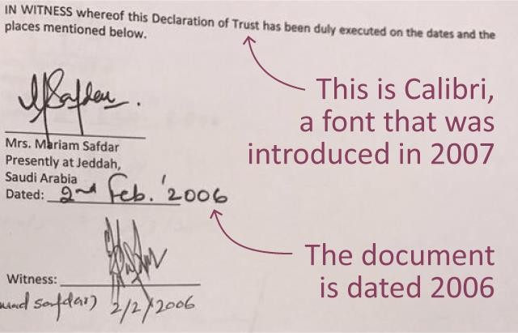

Slide 4
What is Evidence ?
Evidence is information that tends to prove or disprove a fact in question.
Evidence may consist of documents, public records, affidavits or the testimony of witnesses.
It also may be an object, such as a murder weapon, whose existence or appearance provides information about the fact in question.
Each party to a legal dispute presents evidence to the court. The court considers the evidence and decides the disputed facts.
The law of evidence is the law of the place where an action is instituted which governs the Courts. (Law of Land)

Slide 5
What is Evidence ?
The law of evidence is a part of the law of procedure. The Indian Evidence Act applies to all judicial proceedings before any court or court martial
Whether a witness is competent or not
Whether a certain matter requires to be proved by writing or not
Whether a certain evidence proves a certain fact or not
Is to be determined by the law of the country where the question arises

Slide 6
Electronic Evidence:
Collection and Preservation

Slide 7
Technological revolution in and information technology.
Impact of Social Media
communication
All Stake holders of judicial Justice system are to be equipped with the use of latest technology and forensic investigation techniques
Public prosecutors and lawyers also require awareness on usage of Digital evidence and relevant case laws!

Slide 8
Cyber Crime
Cyber crime is defined as a crime in which an electronic communication Device is the object of the crime, or used as a tool / target or used incidental or as a witness to commit an offence.
Cyber criminals may use Information technology to access personal information, business trade secrets, use the internet for exploitive or malicious purposes.

Slide 9
Evidence…
Evidence is evidence !
Regardless of whether the evidence is physical evidence, trace evidence, biological matter, or electronic evidence residing on a specialized device, all evidence must be treated the same
Integrity must be protected at all times

Slide 10
Types of Evidence in Legal Terms
Two general kinds of evidence, direct evidence and circumstantial evidence.
Direct evidence tends to prove a fact without the help of other evidence.
E.g. an eyewitness to a murder gives direct evidence by testifying that he or she saw the accused kill the victim.
Circumstantial evidence tends to prove facts that support the main fact in question, but it does not tend directly to prove the main fact itself.
Witnesses give circumstantial evidence by testifying that they saw the accused leave the murder scene.
This evidence indicates that the defendant could have killed the victim, but by itself it does not tend directly to prove it
If evidence about a fact is lacking, a rule of law may state that the fact is proved by other facts. Such a statement is called a presumption.
E.g. proof that someone has been missing for at least seven years may result in the presumption that he or she is dead. Whenever a court presumes a fact, it may either regard such fact as proved, unless and until it is disproved, may call for proof of it.

Slide 11
Types of Evidence : Electronic
Primary Evidence
Secondary Evidence

Slide 12
Electronic Evidence is Primary or Secondary?
Input: 65B IndianEvidenceAct
Binary Equivalent:
00110110 00110101 01000010 01001001
01101110 01100100 01101001 01100001
01101110 01000101 01110110 01101001
01100100 01100101 01101110 01100011
01100101 01000001 01100011 01110100

Slide 13
Evolution of Electronic Evidence
1984, the FBI began to use computer evidence
In 1991, a new term; "Computer Forensics" was coined
In India IT Act 2000.
On 17th October 2000, ITA 2000 was notified and along with it the Indian Evidence Act 1872 got amended with several new sections being added to address the issue of Electronic Evidence

Slide 14
Electronic Evidence
Evidence in digital form
Data recovered from digital devices
Data relating to digital devices

Slide 15
Characteristics of Electronic Evidence
Is invisible
Is easily altered or destroyed
Requires precautions to prevent alteration
Requires special tools and equipment
Requires specialized training
Requires expert testimony

Slide 16
Where is Electronic Evidence?
Any kind of storage device
Computers, CD’s, DVD’s, floppy disks, hard drives, thumb drives
Digital cameras, memory sticks and memory/ SIM cards, PDA’s, cell phones
– Fax machines, answering machines, Scanners,
Printers, Copiers
– CCTV

Slide 17
Type of Files
Audio
Video
Text

Slide 18
A new challenge!
Cyber crimes are being committed in cyberspace. Evidence in these crimes is almost always recorded in a digital fashion.
Acquisition, Authentication, and legal Admissibility of information stored on magnetic and or any other storage media can be referred as Electronic evidence.
Computer forensics is the application of science and engineering to the legal problem of Electronic evidence. It is a synthesis of science and law.

Slide 19
Role of Electronic Evidence in Crime Investigation
Evidence from tech devices continues to play a larger role in the search for justice.
“To try to show what happened – how it happened
– when it happened,”
“The fact is that everything that we do has some sort of digital component,”
“The fit bit along with smart watches/mobile phones
– They know everywhere you go - the devices are always
tracking information – that’s changing the game dramatically

Slide 20
Challenges with Electronic Evidence
Electronic evidence, by its very nature is invisible to the eye, must be developed using tools other than the human eye.
Each step requires the use of tools or knowledge, the process must be documented, reliable and repeatable.
The process itself must be understandable to the court.

Slide 21
Challenges with Electronic Evidence…
Acquisition of evidence is both a legal and technical problem.
The law specifies what can be seized, under what conditions, from whom, and from where it may be seized. The determination of what a particular piece of digital evidence is, requires its examination.

Slide 22
Documentary Evidence
Section 2(t) of IT Act 2000 electronic record means;
“data, record or data generated, image or sound stored, received or sent in an electronic form or micro film or computer generated micro fiche;”

Slide 23
Search and seizure
Crpc Provisions (Criminal Procedure Code)
Sec 93
Sec 165
IT Act 2000: sec .80
Independent witnesses, video, photo

Slide 24
IT ACT 2000
Sec.80. Power of police officer and other officers to enter, search, etc.-(1) Notwithstanding anything contained in the Code of Criminal Procedure, 1973, any police officer, not below the rank of a Inspector of Police, or any other officer of the Central Government or a State Government authorised by the Central Government in this behalf may enter any public place and search and arrest without warrant any person found therein who is reasonably suspected or having committed or of committing or of being about to commit any offence under this Act.

Slide 25
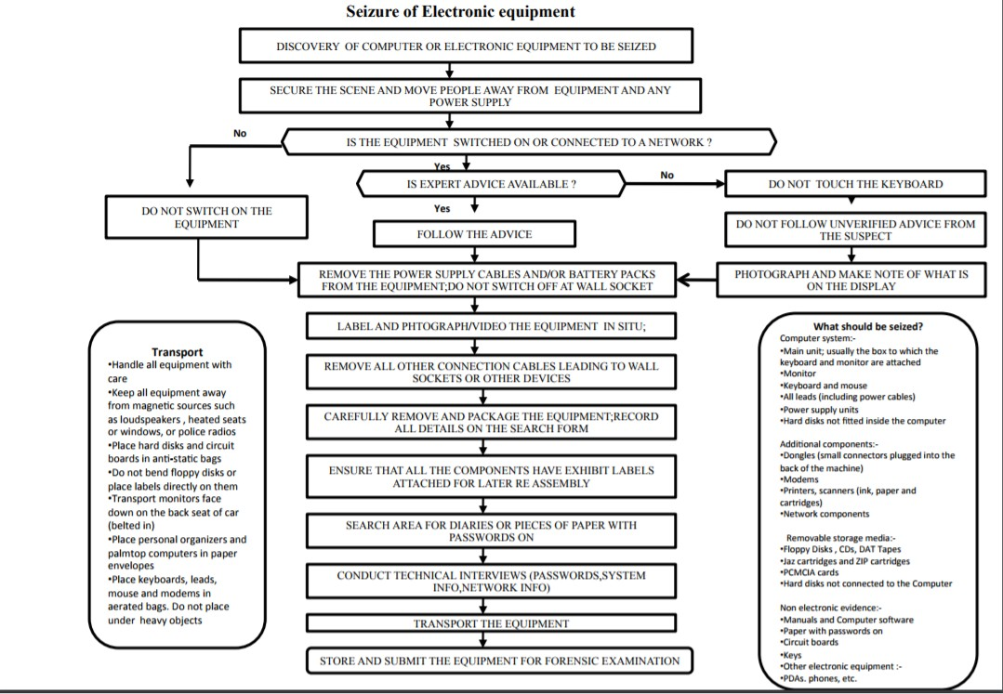

Slide 26
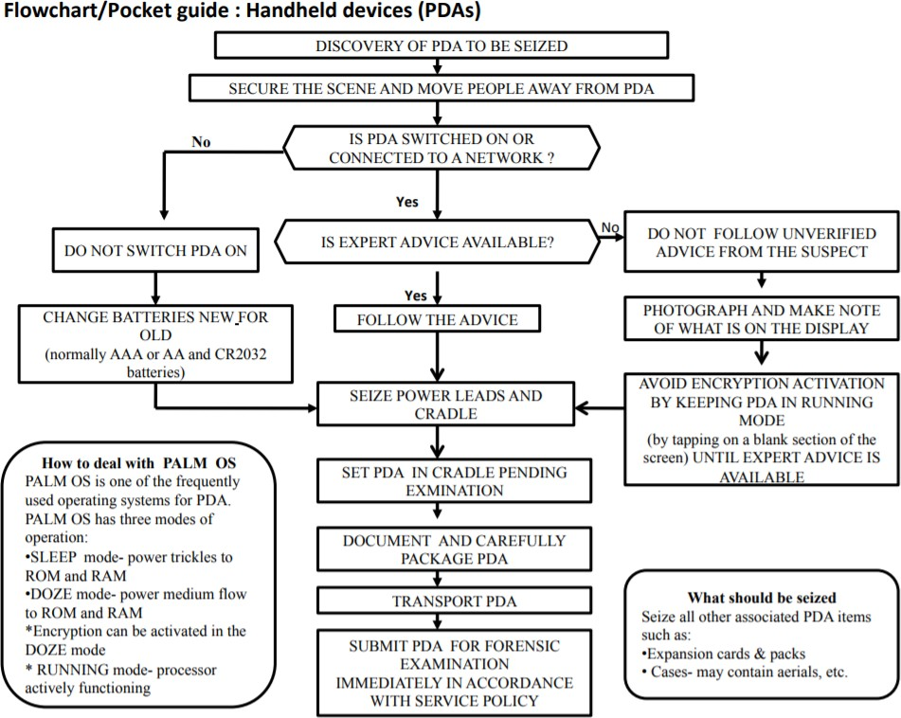

Slide 27
Chain of custody: Preservation of Evidence
Chain of Custody – A process that tracks the movement of evidence through its collection, safeguarding, and analysis lifecycle by documenting each person who handled the evidence, the date/time it was collected or transferred, and the purpose for any transfers
SOP

Slide 28
Forensic Methodologies
Traditional Forensics
Analyzing a “dead” system that has had it’s power cord pulled
Least chance of modifying data on disk, but “live” data is lost forever
Live Forensics (Often Incident Response)
– Methodology which advocates extracting “live” system data before pulling the cord to preserve memory, process, and network information that would be lost with traditional forensic approach

Slide 29
Deleting a file
Deleting a file
When a file is simply deleted or erased pointers to the file are “zeroed” (i.e. alterations are made to the FAT or MFT) so that at the logical level the file does not appear to the user, but at the physical level the file data is still intact on the media and may be recovered.

Slide 30
Wiping a file
Wiping a file
when a file is wiped the entirety of the file is overwritten by a known or random hex character or pattern rendering it unrecoverable

Slide 31
Hash value
A hash value is a result of a calculation (hash algorithm) that can be performed on a string of text, electronic file or entire hard drives contents.
The result is also referred to as a checksum, hash code or hashes. Hash values are used to identify and filter duplicate files (i.e. email, attachments, and loose files) from verify that a forensic copy or clone was captured successfully.
Each hashing algorithm uses a specific number of bytes to store a “ thumbprint” of the contents.
– MD5: 464668D58274A7840E264E8739884247
– SHA-1: 4698215F643BECFF6C6F3D2BF447ACE0C067149E

Slide 32
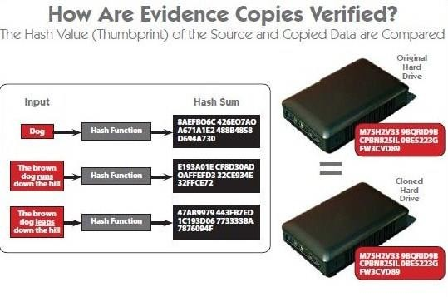

Slide 33
Provisions for the Proof of Electronic Evidence : IT Act 2000
65A. Special provisions as to evidence relating to electronic record
65B. Admissibility of electronic records
67A. Proof as to digital signature
73A. Proof as to verification of digital signature
81A. Presumption as to Gazettes in electronic forms
85A. Presumption as to electronic agreements
85B. Presumption as to electronic records and digital signatures 85C.
Presumption as to Digital Signature Certificates
85C. Presumption as to Digital Signature Certificates
88A. Presumption as to electronic messages
90A. Presumption as to electronic records five years old
131. Production of documents or electronic records which another person, having possession, could refuse to produce

Slide 34
Social Media
Online Social Networking (OSN)
More than 200 Social Network sites,
only 15 are most popular Social networks based on number users Viz
Face book, twitter whats app, imo,YouTube etc.

Slide 35
Social Media Issues Complexity
1.Harrasment,humilations,cyber bullying
2.Use,misuse and Abuse of Art .19 of Indian Constitution: Freedom of Speech
3.Sec 506, 153,A,B ,354C,D
4. Netizen Rights
5.Ban on Social Media
6.Sec 144 Crpc
7.Sec 5 of ITA 1885

Slide 36
Free wifi
All the Airports are connected with free wifi for an hour at least.
Google likely to install free wifi on 140 railway stations
Google not only has access to all your search records but also to metadata/search analytics from all your connected devices now.

Slide 37
Are you safe with your e mail Accounts?
Gmail, yahoo, etc not safe
No social media platform is safe
icloud also not safe!
Use privacy settings
Try to use your own e mail accounts..

Slide 38
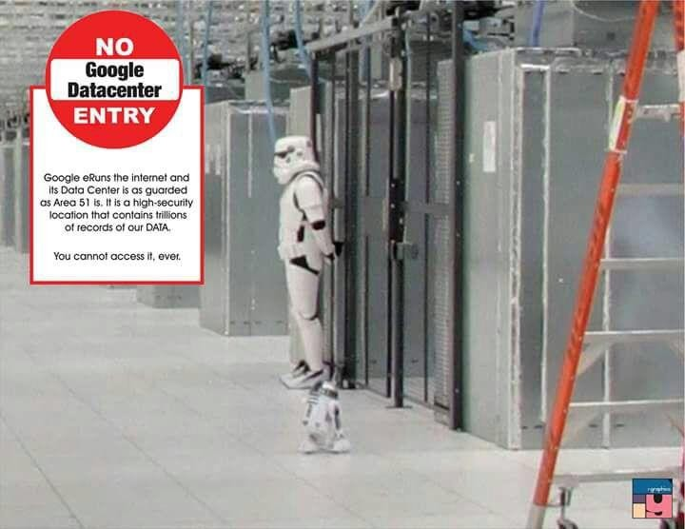

Slide 39
Need for Data Protection Law
Presently all our Data namely Search, Emails, Chat, Google, FB, Hotmail, Whatsapp are stored in Californian Servers ,USA Jurisdiction.
US Foreign Intelligence Survielance Court (FISC) with a single court order can take all Indian MPs, PMO, Home Minister, MEA's etc Email data and analyze them for leverage in Intl' Affairs. That’s a severe threat, privacy intrusion.
Not to mention even the Locations of each Citizen, Official in India can be monitored by US NSA analysts as of now with Whatsapp, Android Phones relaying data back to USA servers.
Hence a Data Protection Law in India is the need of the hour.
Current provisions are not sufficient to meet legal requirements.

Slide 40
Data Protection Law
The Govt has appointed an expert committee, headed by former Supreme Court Judge B.N. Srikrishna, to “identify key data protection issues” in India and recommend methods to address any potential problems.
The committee has been appointed in view of the “growing importance of data protection India.”
“The need to ensure growth of the digital economy while keeping personal data of citizens secure and protected is
of utmost importance,” the circular further
entrusting the committee with the task of
states,
putting
together a draft data protection bill, and submitting its report “as expeditiously as possible”....

Slide 41
Aadhaar
E-authentication a must to curb Aadhaar frauds
Now many agencies try to link your ID with Aadhaar,
Don’t link with the paper-based Aadhaar.
Either it should be biometrically authenticated or Aadhaar OTP should be verified.
Once you biometrically authenticate, then the possibility of somebody giving a fake Aadhaar or giving somebody else’s Aadhaar number and linking it with a different PAN or account is ruled out.

Slide 42
Indian Cyber Laws
Indian Cyber Laws were officially born on 17th October 2000 with the Information Technology Act, 2000 coming into force.
The Indian Penal Code (as amended by the IT Act) penalizes several cyber crimes. These include forgery of electronic records, cyber frauds, destroying electronic evidence etc.
Digital Evidence is to be collected and proven in court as per the provisions of the Indian Evidence Act (as amended by the IT Act).
In case of bank records, the provisions of the Bankers’ Book
Evidence Act (as amended by the IT Act) are relevant.
Investigation and adjudication of cyber crimes is done in accordance with the provisions of the Code of Criminal Procedure and the IT Act.

Slide 43
Admissibility: Before Court
Evidence collection
Correct legal processes
Accepted techniques and tools
Properly trained personnel
Chain of custody
Testimony of Experts
Corroboration (Evidence Confirmation)

Slide 44
Admissibility of Electronic Evidence
65A and 65B are introduced to the Evidence Act under the Second
Schedule to the IT Act.
Section 5 of the Evidence Act provides that evidence can be given regarding only facts that are at issue or of relevance.
Section 136 empowers a judge to decide on the admissibility of the evidence. Section 65A provides that the contents of electronic records may be proved in accordance with the provisions of Section 65B.
Section 65B provides that notwithstanding anything contained in the Evidence Act, any information contained in an electronic record (ie, the contents of a document or communication printed on paper that has been stored, recorded and copied in optical or magnetic media produced by a computer ('computer output')), is deemed to be a document and is admissible in evidence without further proof of the original's production, provided that the conditions set out in Section 65B(2) to (5) are satisfied.

Slide 45
The Criminal Aspect in Cyber Law
Vishram V Kunte
16th Sept 2023

Slide 46
Legislations on Computer Crime, World-wide
Many of the industrialized countries have beefed themselves up against digital crime to combat the challenges posed by new kinds of techno-crime, popularly known as the 'cyber crime‘ enabled by the advancement of computer technology,.
A few of the developing countries have also evinced interest in fighting against this menace.
A number of countries have introduced extensive amendments to their substantive criminal law.
These are USA, Austria, Denmark, France Germany, Greece, Finland, Italy, Turkey, Sweden, Switzerland, Australia, Canada and Japan. The salient features of the Legislations of different countries are narrated below.

Slide 47
Legislations: World-wide
Australia has included offences relating to computers in the ‘Australian Crime Act‘. The penalty for unlawful access to data in computers is imprisonment from 6 months to 3 years. The penalty for damaging data in computers, is imprisonment up to 10 years.
Canada has named three computer crime namely (a) Possession of devices to obtain unauthorized telephone facilities, ([2) Unauthorized access to computer and (c) Committing mischief with data. The imprisonment varies f‌rom 2 years up to 10 years depending upon the crime.

Slide 48
Legislations: World-wide
Germany has classified the following offences as computer crime: Data spying, Computer fraud, Alteration of data, Computer sabotage. The punishment varies from up to 2 years to up to 5 years depending upon the nature of crime.
Japan has amended its penal code and has classified following activities as computer crime. Electronic record made wrongfully, Electronic record wrongfully made by a public servant, False entry in an authentic deed, False entry in permit license or passport, Interference with business by destruction or damage of computerized data, Interference with computer and Destruction of private documents, Destruction of public documents.

Slide 49
Legislations: World-wide
Singapore has classified the following activities as computer crime, in its ‘Computer Misuse Act' - Unauthorized access to computer material, Unauthorized access to computer systems with intent to commit or facilitate commission of further offences, Unauthorized modification of computer material, Unauthorized use and interception of computer services. The punishment varies from fine up to Singapore 2000-20000 dollar and/or imprisonment of 2-5 years duration.
In their ‘Computer Misuse Act', UK has included unauthorized access to computer material and unauthorized access to computer systems with intent to commit or facilitate commission of further offences, as the computer crime. The punishment stipulated is imprisonment from 6 months to 5 years.

Slide 50
Legislations: World-wide
United States has made extensive amendments to its laws, classifying the following as computer crime
Causing transmission of data/program, knowing that such transmission will damage a computer network, data or program or that such transmission will withhold or deny use of computer, network etc.
Intentional unauthorized access of computer to obtain financial information
Willful unauthorized access of computer data related to national defense or foreign relation
Knowingly causing transmission of data/program to damage a computer network, data
Unauthorized access of computer with intent to defraud.
Unauthorized access of computer of a Government Department or Agency.
Unauthorized access of computer/computer data of Federal interest with intent to defraud.

Slide 51



